Slide 1
VLSI ROUTING-1

Slide 2


Slide 3
Output of the Placement Phase
 Exact locations of circuit blocks and pins are determined
 A netlist is generated which specifies the required interconnections
 Region for interconnections (routing region) is also generated in this phase

Slide 4
Routing
Complete the interconnections among modules. Factors like critical path, clock skew, crosstalk, congestion, repeater placement, wire spacing, … are considered. Includes global routing and detailed routing.
Around 60% of the overall design time is spent on routing!!

Slide 5
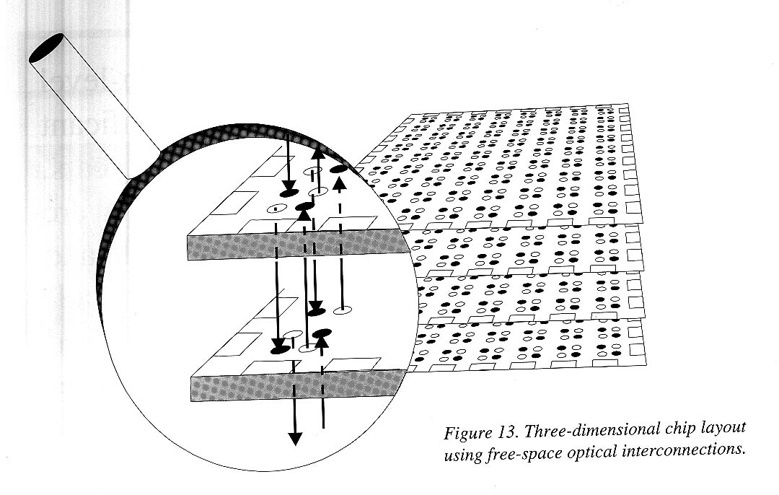
Routing Example
Three-dimensional chip layout using optical interconnection
D. Stroobandt, Recent advances in system-level interconnect prediction, IEEE Circuits and Systems Magazine, vol. 11 (4), 2000

Slide 6
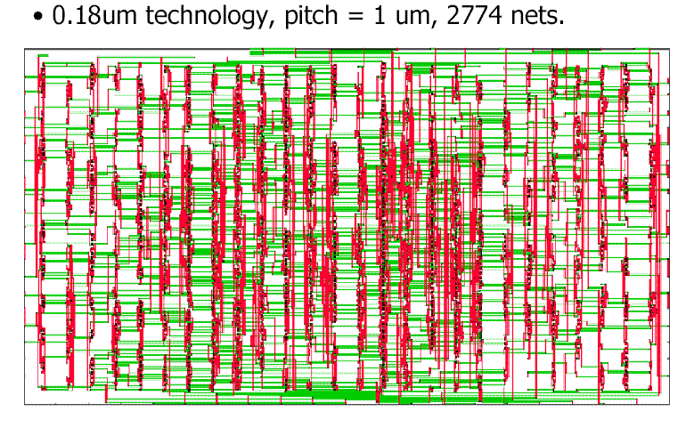
Routing Example

Slide 7
Routing Regions
Channels :
A rectangular area bounded by two opposite sides by the blocks
Switchbox:
A rectangular area bounded on all sides
Channel Terminals
Blocks
Switchbox

Slide 8
Routing Regions
Capacity of a channel (C)
= number of layers (l) × height (h)/(wire width(w) + wire separation(s) )
For, l =2, h =18λ, w =3, and s =3, C becomes 6
Channel Terminals
Blocks
Switchbox

Slide 9
Objective of Routing
 To complete the interconnections among the blocks according to the specified netlist
 While interconnecting, each net satisfy different constraints
 Optimize various criteria for better performance

Slide 10
Constraint of routing
While interconnecting it must follow some
 Design specification
 Design style

Slide 11
Design specifications
 Fixed number of layers
 Separation between two nets
 Net width (different for each net)
 Heat dissipation problem
 Significant yield problem
etc.

Slide 12
Optimization Criteria
 100% routing
 Less area
 Minimization of total wire-length
 Minimization of change of layers for interconnection
 Reduce net length for critical nets
and many others for specific design style and specification.

Slide 13
Difficulties for finding a routing solution
 Many of these objective functions are conflicting in nature
 Most of these optimization problems are
NP-complete or NP-hard

Slide 14
Way for finding a solution
Instead of solving the problem optimally,
– Solve the problem in polynomial time with near optimal results (Heuristic / Approximation algorithm)
– Solve a simpler (or restricted) version of the problem
Helps to generate the good solution of the routing problem.

Slide 15
Steps of routing
Placement
 Determine the routing regions
 Generate the loose route for each net
 Assign a list of routing regions to each net without specifying the actual layout of wires
Global Routing
 Find the actual geometric layout within the assigned routing regions
Detailed Routing
Compaction

Slide 16
Examples of Global and Detailed Routing
Global Routing
Detailed Routing

Slide 17
Global Routing

Slide 18
Graph Model used in Global Routing
 Graphs are used to represent the geometric information
1. Grid graph model
2. Checker board model
3. Channel intersection graph model

Slide 19
Grid Graph Model
 Each cell is represented by a vertex
 Two vertices are adjacent if the corresponding cells share the same boundary
 The occupied cells are represented as blocked vertices (filled circle)

Slide 20
Checker Board Graph
 General model of grid graph
 Each edge is having a weight depending on the area available for routing in the adjacent cell boundary
5
20
20
5
10
Checker board graph of a floorplan

Slide 21
Channel Intersection Graph
 Channels are represented as edge
 Channel intersections are represented as vertices
 Edge weight represents channel capacity

Slide 22
Problem Formulation for Global Routing
Steiner Minimum Tree:
Given a connected graph G = (V,E), and a subset V* in V, find a minimal tree in G which spans the vertices in V* (and possibly more)
Input: A netlist N = {N₁, N₂,……N_{n}} The routing graph G = (V, E)
Objective: Find a Steiner tree T_{i} for each net N_{i}, 1< i < n such that 1. Σ Len (T_{i}) is minimized
2. Max (Len (T_{i})) is minimized
Subject to conditions
U(e_{j}) < C(e_{j}) for all e_{j} ∈ E
where Len (T_{i}) = the length of the Steiner tree T_{i} C (e_{j}) = capacity of edge (e_{j}) U (e_{j}) = the number of wires that pass through the channel corresponding to edge e_{j}

Slide 23
Maze Routing
– Problem of finding shortest path between two terminals on a grid with obstacles
– Lee (1961) proposed a simple algorithm
– An improvement by Soukup (1978)
– Hadlock (1977) proposed an alternative approach using A* search technique

Slide 24
Lee’s Algorithm
– Simple algorithm
– Lee’s algorithm guarantees shortest route
– Essentially a BFS algorithm
– In worst case it scan all the entries
– Time and space complexity is high

Slide 25
Steps of Lee’s Algorithm
 Start from source terminal, label all adjacent vertices by 1
 Any unlabeled vertices which are adjacent to a grid point with label i is assigned by label i+1
 All label i’s are assigned first before assigning any label i+1
\* The label of a point indicates it’s distance from source *\
 Repeat the process until we reach sink terminal

Slide 26
An example routed by Lee’s Method
3
2
3
4
5
6
7
8
9
2
1
2
3
4
5
6
7
8
1
s
1
5
6
7
8
9
2
1
2
9
10
3
2
3
9
t
10
4
3
4
8
9
10
5
4
5
6
7
8
9
10

Slide 27
Analysis of Lee’s Method
Time Complexity: O(h × w)
Space Complexity: O(h × w)
t
4
3
2
3
Worst case in Lee’s Algorithm
3
3
2
1
2
2
2
1
s
1
3
3
2
1
2
2
3
4
4
3

Slide 28
Soukup’s Algorithm
– An iterative algorithm
– Faster algorithm compared to Lee’s method
– Essentially a DFS algorithm
– It guarantees to determine a path between source and target if exist
– Path may not be shortest one
– Worst case time and space complexity are both O(h× w) for a grid of size h× w

Slide 29
Steps of Soukup’s Algorithm
 During each iteration, the algorithm explores the direction towards the target
 It does not change the direction until it goes away from the target or it reaches the target /obstacle
 If an obstacle is reached, the breadth-first search is employed until a vertex is found which can be used to continue the search, in the direction towards the target

Slide 30
An example routed by Soukup’s Method
14
13
9
12
10
s
11
8
1
4
6
2
3
t
21
15
7
5
16
17
18
19
20

Slide 31
An example: Soukup’s Method
2
3
4
5
t
8
7
6
1
15
s
9
10
11
12
13
14
Sokup’s Method may not find the shortest path

Slide 32
An example: Soukup’s Method
4
3
2
1
s
5
6
7
8
9
10
11
12
t
13
16
15
14
Worst case in Sokup’s Method

